Slide 1


ELECTRON BOOTCAMP
Learning Electron with DEV6

Slide 2
Course Objectives
DEV6’s Electron Bootcamp Course teaches developers how to use Electron to create modern desktop applications.

Slide 3
Course Roadmap
Introduction & Installation
Understanding Electron Application Architecture
Electron Features
Electron API’s
Electron Userland
Native Addons
Notes:
There is a lab exercise at the end of each module. During the course we will make a fully functional electron app named Shirtastic.
The lab will consists of :
Environment Set up for Electron development.
An existing JavaScript web app into electron app.
Adding native notifications , file read operation , native menus , http communication.
Then we will tackle some advance features of Electron like Crash Reporting, Generating Installers.
And in the last lab we will set up Electron app for hosting and consuming auto-updates.

Slide 4
Student Background
Fairly good understanding of HTML and CSS.
Some understanding of JavaScript.
No prior understanding of Electron.

Slide 5

Module 1: Introduction and installation

Slide 6
What is ELECTRON?
Open-source library developed by GitHub for building cross-platform desktop applications with HTML, CSS and JavaScript.
Node integration to grant access to the low level system from web pages.
Electron accomplishes this by combining Chromium and Node.js into a single runtime and apps can be packaged for Mac, Windows, and Linux.
Notes:
Chromium is for Front End.
Chromium is the open source part of Google’s chrome browser. > maintained by Chromium Project Team .
Chrome is maintained by Google itself.
Node.js backend.
Node.js is powered by V8 , which is again Chrome’s JavaScript engine.
So, we can see here there is a nice tuning going on between the front-end and the back-end of Electron.

Slide 7
Brief History of ELECTRON
2013 – Electron began as the framework on which Atom was built. Originally it was called as Atom Shell and developed by Cheng Zhao.
2014 – Atom and Atom Shell both got open sourced in May 2014.
2015 – Atom Shell got renamed to Electron in April 2015.
2016 – Electron v1.0.0 released in May 2016.
2016 – Electron apps compatible with Mac App Store in May 2016.
2017 – Windows Store support for Electron apps in August 2016.
2018 – Electron v2.0.0 released in May 2018.
2018 – Electron v3.0.0 released in September 2018.
2018 – Electron v4.0.0 released in December 2018.

Slide 8
Why desktop apps instead of web apps?
Constant connectivity with Internet is not required.
Dock Icon, Desktop shortcuts, Keyboard shortcuts and Native notifications.
Hosting is cheaper.
Works with peripheral devices and other local hardware.
It will be available in App Store.
Desktop apps are making a comeback !

Slide 9
Why use electron?
Single code base and 3 platforms
Mac
Windows
Linux
Open source
Maintained by GitHub team
Automatic Updates
Code once, distribute everywhere
Native Menus & Notifications
Crash Reporting
Debugging & Profiling
Windows Installers
Deployment and Build Process
Electron-Userland
Notes:
Automatic Updates is currently not supported on Linux. Electron team recommends to use the distribution package manager to update linux app.

Slide 10

















APPS BUILT ON ELECTRON
Notes:
Brave Browser ->Web browser that automatically blocks ads and trackers. Founded by Brendan Eich who is the creator of Javascript programming.Currently he is CEO of Brave Software.
Jibo -> The first social robot for home.
Pexels -> Search for completely free photos and copy them into your clipboard
Beaker Browser -> An experimental P2P browser
Etcher -> Etcher is a powerful OS image flasher built with web technologies to ensure flashing an SDCard or USB drive is a pleasant and safe experience. It protects you from accidentally writing to your hard-drives, ensures every byte of data was written correctly and much more.
MailSpring -> Email Client written in Electron + React .
Most importantly linux users are not left out. All these great user experience is available to users of all 3 platform users.

Slide 11
installation
Install Electron as a development dependency
npm install electron –-save-dev
Global installation
npm install electron -g

Slide 12
exercise
Environment Setup

Slide 13
Module 2: understanding electron application architecture

Slide 14
architecture
Chromium
for making web pages
Node.js
for filesystems and networks
Native APIs for three systems
ELECTRON
Notes:
At its core, Electron consists of three components.
Chromium:
It embeds Chromium’s rendering library (known as libchromiumcontent), which is the open source foundation for Google’s browser Chrome. With it comes support for the latest web standards, a performant JavaScript engine, and constantly improving developer tools. It is a common misconception that Electron includes Chrome in its entirety; to keep Electron as lean as possible, it really does just contain Chromium’s rendering library.
Node.js
The second component is Node.js, the popular JavaScript runtime built on top of V8 (the same JavaScript engine that powers libchromiumcontent and Chrome). It brings a vibrant open source ecosystem to the table: countless modules on npm offer battle-tested solutions for common development tasks and easy integration with virtually any service. Node.js rightfully claims to be the “largest ecosystem of open source libraries in the world,” a benefit that can dramatically reduce the amount of time needed to develop solutions.
Native APIs
The third component is a thick layer of C++, extending the usual set of available APIs with native implementations for common operating system operations such as sending native notifications, accessing system preferences, and creating native dialogs. In addition, Node.js allows the use of native modules—native components written in C, C++, Rust, or Objective-C—ensuring that the developer is never limited to JavaScript should a complicated problem require the use of a low-level programming language.
Electron
Combining Chromium and Node.js, and throwing in a large number of natively implemented APIs, Electron enables developers to build powerful desktop applications with little effort. All three technologies are cross-platform, supporting Windows, macOS, and Linux alike.

Slide 15
Electron under the hood
Main Process
Renderer Process
Renderer Process
Renderer Process
Notes:
As soon as the main process has initialized, it is able to open windows. Those windows run in their own process and are referred to as renderer processes.
In Electron, each web page runs in its own process.
The distinction is important: Renderer processes have the familiar DOM with window and document objects, can create and render HTML elements, and have Chromium’s developer tools available, whereas the main process is really just a Node.js process.
At the same time, many of Electron’s APIs can only be accessed from the main process: calling methods that perform native GUI operations from a renderer process is risky, likely to leak resources, and therefore simply not allowed.
The main process manages and facilitates communication with each renderer process.
The renderer processes communicate in turn with the main process, but do not usually bother talking to other renderer processes.
This communication is facilitated by Chromium’s multiprocess architecture, enabling developers to pass objects between processes and to even call methods on one process from another.

Slide 16
exercise
Converting Existing JavaScript WebApp into Electron Desktop App

Slide 17
Module 3: electron features

Slide 18



SUPPORTS THREE PLATFORMS
Code once, distribute everywhere.
Reusability
Notes:
Reusability -> Same code can be used for both web and desktop applications.

Slide 19
Code and app management
Single requirement document
Single team
Single code base
Cost and time
Notes:
Example of how small the teams are behind popular Electron applications.
Microsoft’s Visual Studio Code was initially built by 7 engineers.
Slack’s desktop app by just 2.
GitHub’s desktop app by 4.
Still developer should focus on OS level functionalities to test out the feature on different platform.

Slide 20



Low-level/hardware accessibility
Keyboard Shortcuts
Low-level accessibility to hardware and operations system components

Slide 21

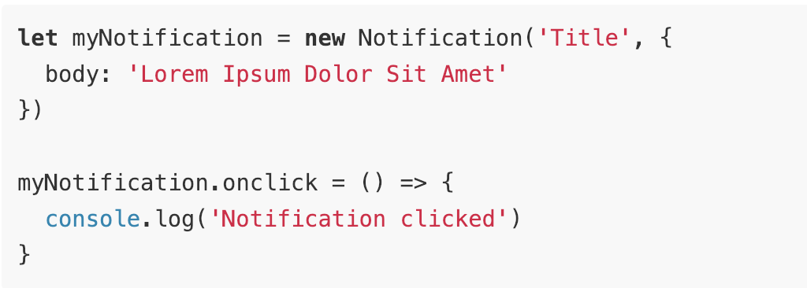
Native menus/notifications
Native menus
Native notifications
https://electronjs.org/docs/tutorial/notifications
Notes:
Native Menus
Native application menus and context menus
Native Notification
Electron uses HTML5 Notification API, using the currently running operating system’s native notification APIs to display it.
To detect whether or not you are allowed to send a notification using the userland module electron-notification-state.

Slide 22

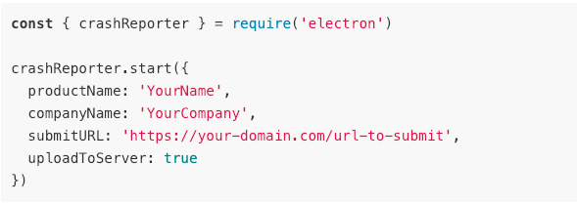
Crash reporting
Helps you submit crash reports to a remote server
https://electronjs.org/docs/api/crash-reporter
Notes:
For setting up a server to process crash reports, you can use many available projects like Socorro, mini-breakpad-server. I have used simple-breakpad-server. You can also use 3rd party hosted solutions like Backtrace I/O, Sentry.
Demo crash reporting feature from Electron-Bootcamp project.
Steps to demonstrate crash:
Go to main.js and uncomment below line
// To crash the main process in order to test Crash Reporting simple-breakpad-server
process.crash();
Go to http://localhost:1127/crashreports to view the list of crash reports generated by electron app.

Slide 23

Debugging and profiling
Collects tracing data from Chromium’s content module for finding performance blocks and slow operations.
Debug Renderer Process using Chromium Developer Toolset.
Debug Main Process using Command Line Switches or External Debuggers.
Notes:
Node Inspector a common tool for debugging Node.js applications is not fully supported by Electron yet. Check the official documentation of Electron in order to see which debugging features are supported.
Alternatively you can use VSCode to debug the main process as well.

Slide 24

Security and your responsibility
Data stays locally in system as it is a desktop application.
Follow security recommendations by Electron team to ensure your desktop application is safe and protected from attackers.
Notes:
In case you want to store data in cloud , check with cloud network for security functions.
Examples of security recommendation:
Only load secure content -> use https.
Disable node integration for render processes which display remote content ->
If an attacker jumps out of renderer process and execute code on user’s computers.
Goal is to limit the powers you grant to remote content.
You can grant additional access to specified hosts.
By having a preload script you can create custom api to be consumed by remotely loaded content.
Disable or limit navigation
Use event.preventDefault()
Check url to allow navigation
Disable or limit creation of new windows
Do not disable web security
If you disable , the same-origin policy policy will be disabled.
Define a Content Security Policy
You can load the scripts to be loaded from specified origins only.

Slide 25

Automatic updates
Built-in Squirrel framework and autoUpdater module.
Electron apps can self update using free and open source webservice update.electronjs.org maintained by GitHub’s Electron team.
Using electron-builder, you can allow updates from any static file host.
If GitHub is not being used for publishing releases, then a dedicated update server can be used.
Currently there is no built-in support for auto-updater on Linux. It is recommended to make use of distribution’s package manager to update the app.
Notes:
3 kinds of things which can be updated for Electron app. .
App -> Non silent update. Then it will be forced to update mode on first launch.
Its dependencies -> Non silent update
Plugins -> Silent update . App will update in the background and user will be notified for a new version.
Easiest way is to take advantage of the built-in Squirrel framework and autoUpdater module.
Squirrel framework checks for updates from the endpoint server. If new release is found , Squirrel will trigger an update. Auto updater module is the interface for Squirrel.
Auto Updater enable apps to automatically update themselves.
update.electronjs.org free webservice -> Electron app has to meet below requirements in order to use this service
App runs on macOS or windows
App has a public Github repo
Builds are published to Github Releases
Builds are code signed.
Electron-builder -> A complete solution to package and build a ready for distribution Electron app for macOS, Windows and Linux with “auto update” support out of the box.
We have to use electron-updater. This mechanism doesn’t require dedicated server and allows updates from S3, Github or any other static file host.
Update Server -> If it’s a private Electron application, its necessary to run your own update server ex: Hazel, electron-release-server.

Slide 26
exercise
Electron Development Tools and Features
Notes:
Two labs will be covered here namely Electron Development Tools and Electron Features

Slide 27
Module 4: electron API’S
Notes:
Before we dig deep into various kind of api’s available. I would like to remind you of two worlds Main process and Renderer Process which we were talking earlier. Now the API’s are also divided in the similar fashion. That is
Main process Api’s (NodeJS) and Renderer process Api’s (Front-end code) . Of course there are some which are available to both the worlds.

Slide 28
Main process - api
app
BrowserWindow
ipcMain
Dialog
Menu, menu-item
Power-monitor
more …

Slide 29
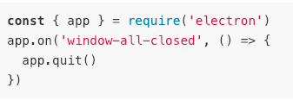
app
Controls application event life cycle.
Various events available:
Ready
Window-all-closed
Before-quit
https://electronjs.org/docs/api/app
Notes:
App -> Control your application's event lifecycle. Various events are present to help you take control of application life cycle. For example window-all-closed, ready, before-quit and many more.

Slide 30
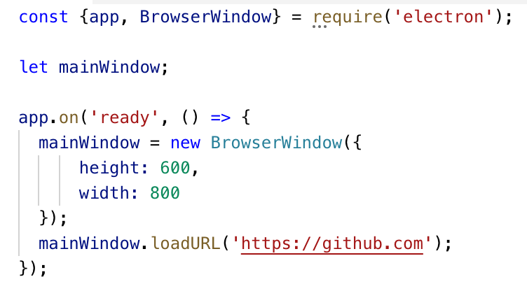
Browser window
Create and control
Frameless window
Parent and child windows
Modal window
Notes:
Frameless windows ->
It’s a window which has no toolbars
Set option frame as false.
Parent and child windows ->
By using parent option you can create child windows
let child = new BrowserWindow({ parent: top })
Modal windows ->
It’s a child window that disables parent window
Set parent and modal options.
let child = new BrowserWindow({ parent: top, modal: true, show: false })

Slide 31
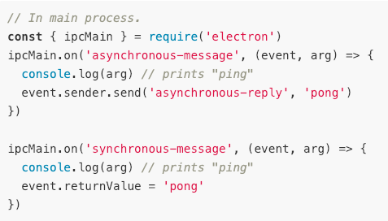
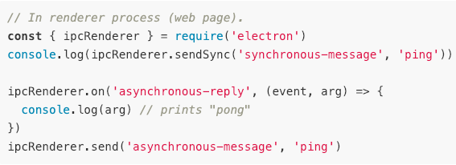
Ipc main
Helps communicating from main to renderer processes.
https://electronjs.org/docs/api/ipc-main
Notes:
Methods to listen for events:
On
Once
removeListener
removeAllListeners

Slide 32
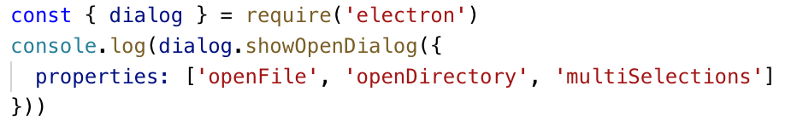
dialog
Display native system dialogs for opening and saving files, alerting etc.
https://electronjs.org/docs/api/dialog
Notes:
Above is an example to show a dialog to select multiple files and directories.

Slide 33
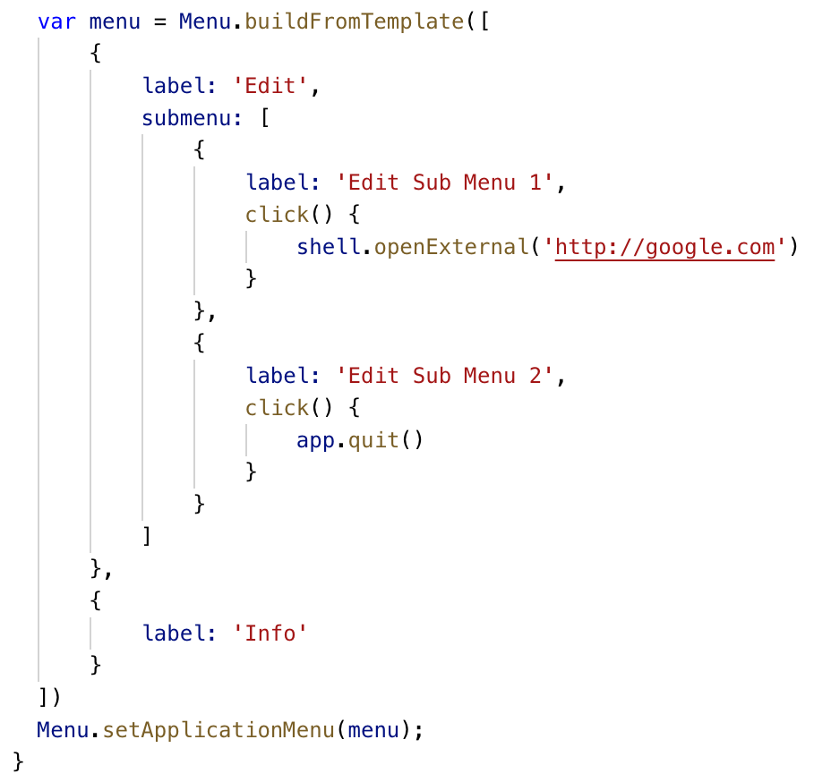
Menu and menu item
Create native application menus and context menus
Notes:
Optional property Roles allow menu items to have predefined behaviors.
Role property can have following values:
Undo
Redo
Cut
Copy
Minimize
maximize

Slide 34
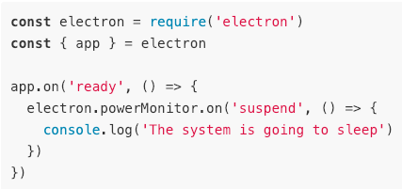
power monitor
Monitor power state changes
Various events available:
Suspend
Resume
On-battery
On-ac
Shutdown
Lock-screen
https://electronjs.org/docs/api/power-monitor

Slide 35
render process - api
desktopCapturer
IpcRenderer
Remote
File Object
Web-frame
more …
Notes:
1.

Slide 36
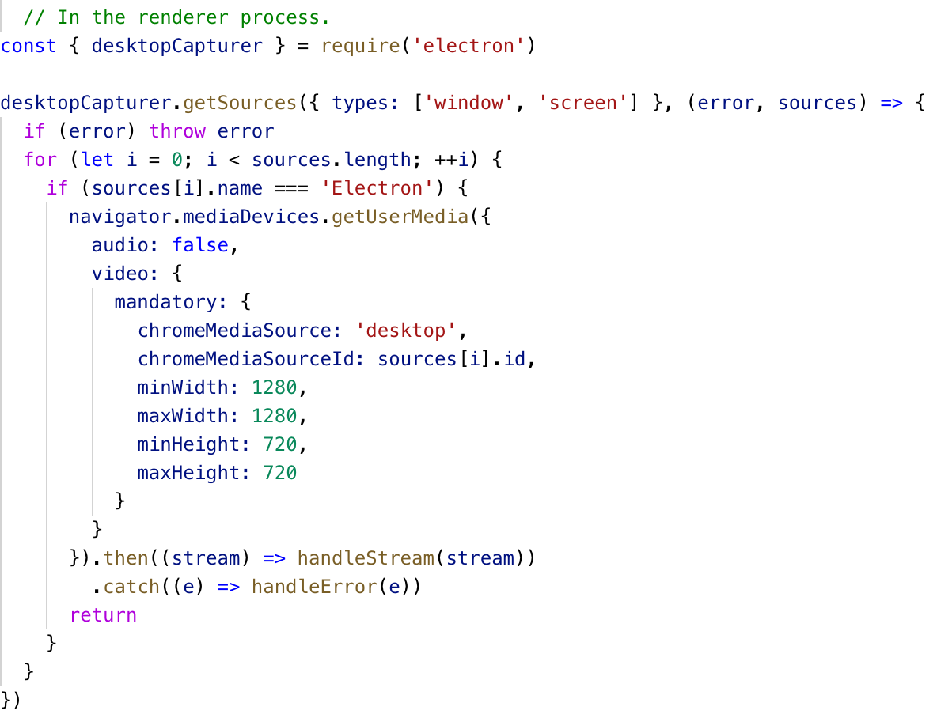
Desktop capturer
Access information about media sources that can be used to capture audio and video from the desktop
https://electronjs.org/docs/api/desktop-capturer

Slide 37
Ipc Renderer
Helps communicating from renderer to main process.
https://electronjs.org/docs/api/ipc-main
Notes:
It is the same example which we covered in ipcMain api for Main process.
Methods to listen for events:
On
Once
removeListener
removeAllListeners

Slide 38
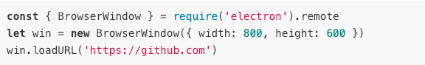
remote
Helps to use main process modules from renderer process(web page)
https://electronjs.org/docs/api/remote
Notes:
GUI modules like dialog, menu and browserWindow are only available in Main process, not in Renderer process, but it can be used in Renderer process by the help of Remote API. Above example shows creation of browser window from a renderer process.
A way of doing IPC.
For the reverse , that is accessing Renderer from main you can use webContents.executeJavascript.
Remote module can be disabled for security reasons for BrowserWindow and <webview> contexts.

Slide 39
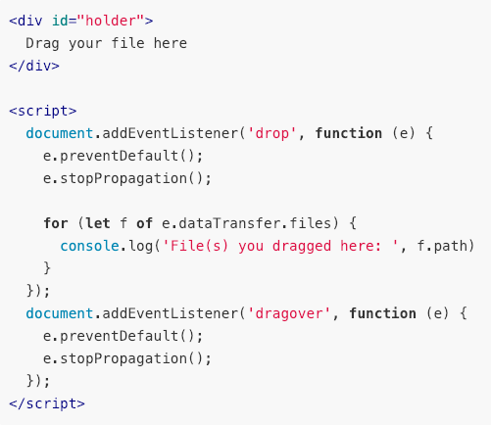
File object
It provides HTML5 File API to work natively with files on the filesystem
https://electronjs.org/docs/api/file-object
Notes:
Above example helps getting path from a dragged-onto-the-app file.

Slide 40
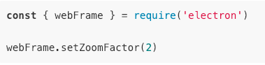
Web frame
For customizing the rendering of the current web page
Various methods available:
setZoomFactor
setZoomLevel
setSpellCheckProvider
https://electronjs.org/docs/api/web-frame
Notes:
Above example demonstrates zooming current page to 200%.

Slide 41
Api available to both process
Clipboard
Crash-reporter
Native-image
Screen
Shell
Synopsis
Process
Environment Variables
Notes:
Starting explaination from first row then second row.
Clipboard -> Perform copy and paste operations on the system clipboard.
CrashReporter -> Submit crash reports to a remote server.
NativeImage -> Create tray, dock, and application icons using PNG or JPG files.
Screen -> Retrieve information about screen size, displays, cursor position, etc.
Shell -> Manage files and URLs using their default applications.
Synopsis -> How to use Node.js and Electron APIs
Process -> Extensions to process object. Electron's process object is extended from the Node.js process object.
Environment Variables -> Control application configuration and behavior without changing code.
THE BASIC RULE IS: IF A MODULE IS GUI OR LOW-LEVEL SYSTEM RELATED, THEN IT SHOULD BE ONLY AVAILABLE IN THE MAIN PROCESS.

Slide 42
exercise
Crash Reporting

Slide 43
Module 5: electron userland

Slide 44
Electron tools
electron-builder
devtron
spectron
electron-reload
more …
Notes:
For more list you can check https://electronjs.org/community.

Slide 45
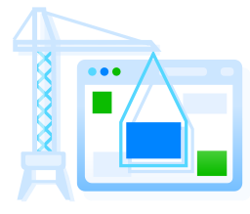
Electron builder
Complete solution to package and build a ready for distribution Electron app for MacOS, Windows and Linux with auto update support out of the box.
Features like:
NPM packages management
Code signing
Auto update
Various target formats
macOS: dmg, pkg
Linux: AppImage, Debian etc.
Windows: nsis, nsis-web Installers and many more…
yarn add electron-builder --dev
https://github.com/electron-userland/electron-builder
Notes:
Create installers.
Yarn is strongly recommended instead of npm by the team.

Slide 46
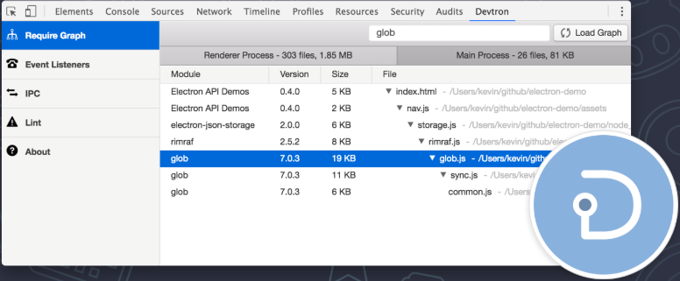
devtron
An Electron DevTools extension to help you inspect, monitor and debug
Features like:
Require graph
IPC monitor
Event Inspector
App Linter
npm install --save-dev devtron
https://github.com/electron/devtron
Notes:
Devtron is an official DevTools extension.
Features:
Require Graph -> View dependencies for both main and renderer process
IPC Monitor -> Tracks messages sent between main and renderer process.
Event Inspector ->Lists out the Events and listeners registered in the app.
App Linter -> Diagnose your app for issues and missing functionality.
After npm install , run below command to see a Devtron tab added.
require(‘devtron’).install()

Slide 47
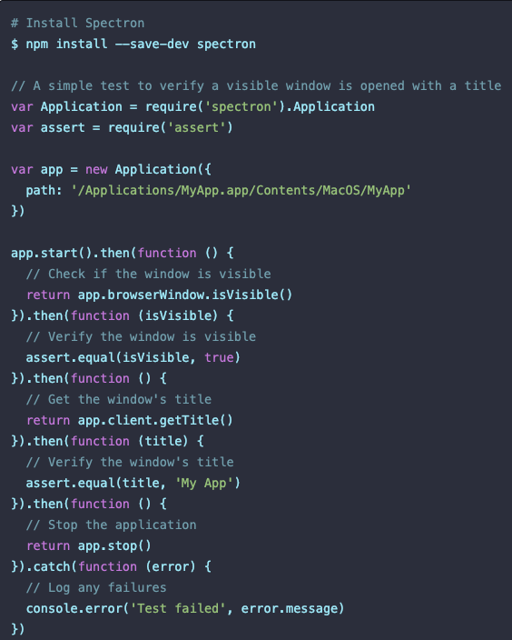
spectron
Perform Integration Test for Electron apps.
Its build on top of ChromeDriver and WebdriverIO.
Spectron supports all testing frameworks.
npm install –save-dev spectron
https://electronjs.org/spectron
Notes:
Chrome Driver -> ChromeDriver is a standalone server which implements WebDriver's wire protocol for Chromium. Its and open source tool for automated testing of webapps across many browsers.
WebdriverIO -> Next-gen webdriver test framework for Node.js..
Unit Tests for Spectron
In order to run unit tests on isolated modules. You can stub the electron package with proxyquire. https://github.com/thlorenz/proxyquire.
https://stackoverflow.com/questions/36351229/how-to-unit-test-components-in-main-process-of-an-electron-app

Slide 48

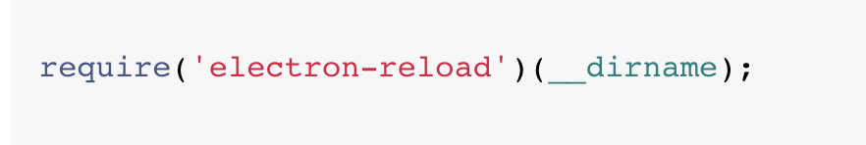
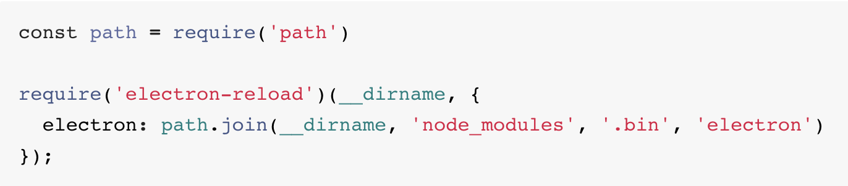
Electron-RELOAD
Enables live reload contents of all active BrowserWindows when the source files are changed.
Soft Reset: It refreshes WebContents alone.
Hard Reset: It starts a new electron process.
npm install electron-reload --save-dev
https://www.npmjs.com/package/electron-reload

Slide 49
Electron boilerplates
electron-boilerplate
electron-react-boilerplate
electron-vue
angular-electron
more …
Notes:
Above are the various boilerplates available to help you jump start in rapid development of Electron application in your favorite Front end technology.

Slide 50
exercise
Generating Installers and Automatic Updates
Notes:
Last Lab.
Tell about the limitation on Linux platform for support of auto updates.
Excerpt from Electron Documentation:
Currently, only macOS and Windows are supported. There is no built-in support for auto-updater on Linux, so it is recommended to use the distribution's package manager to update your app.

Slide 51
resources
Electron Documentation https://electronjs.org/docs
Electron Userland https://github.com/electron-userland
Coursetro https://coursetro.com/courses/22/Creating-Desktop-Apps-with-Electron-Tutorial

Slide 52
Module X: Native Addons
Notes:
Before we dig deep into various kind of api’s available. I would like to remind you of two worlds Main process and Renderer Process which we were talking earlier. Now the API’s are also divided in the similar fashion. That is
Main process Api’s (NodeJS) and Renderer process Api’s (Front-end code) . Of course there are some which are available to both the worlds.

Slide 53
What are Addons and why use them?
These are dynamically-linked shared objects (written in C++) that can be loaded into Node.js and used as if they were an oridinary Node.js module
Addons can be used to drastically speed up your app, and you can use complex C++ libraries to do powerful things in a more efficient manner
Notes:
They’re loaded into the JS file using the require() function after the file is built
They’re used to provide an interface between Node and C/C++ libraries
The method for implementing addons is complicated, we’ll walk you through it

Slide 54
Components and APIs
Building an addon involves some deep knowledge
V8 is the C++ library which Node uses to provide the JS implementation
Node itself exports a number of C++ APIs that addons can use
Notes:
Knowledge of components and APIs
Most important is the node::ObjectWrap class

Slide 55
Project Structure
Each addon should be created in its own folder/directory
There should be a binding.gyp file and the C++ source code
You have to require() the compiled build file in your JS file
With this JS file, you can access the C++ functions/methods
Notes:
The binding.gyp file is where you would define your build
Make sure you use the right name for the source and target
Platform-specific code can be added in with conditionals

Slide 56
exercise
Native Addons
with C++ and Node
Notes:
This lab will cover how to build a simple addon and integrate it into electron

